Slide 1

Proposed Application for: COVID-19 Impact Tracker
Time Series of United States COVID-19
Infections, Hospitalizations, and Deaths
Scott Clement
Luis Resh
GES 771: Advanced Spatial Data Management
Spring 2020

Slide 2
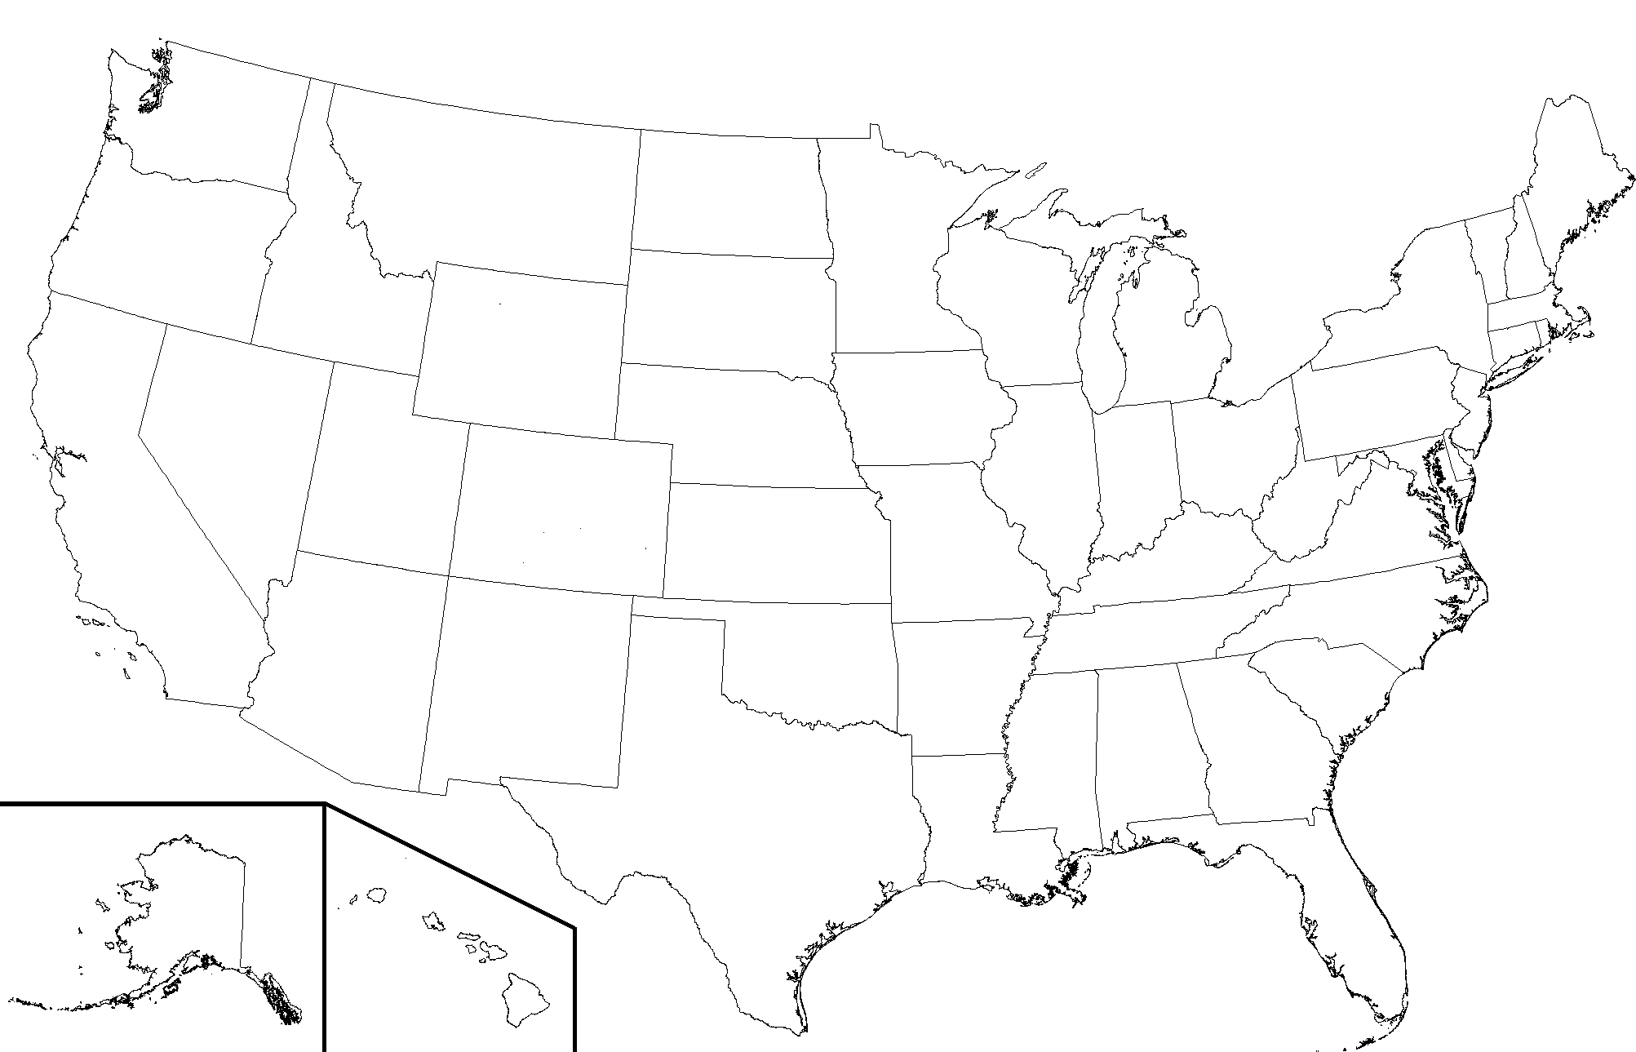

Web Page Mockup
Click on map for state-specific statistics
COVID-19 TRACKER:
Total United States
+
Date: 4/1/2020
Alaska
Alabama
Arkansas
Arizona
California
-
CUM. TESTS
1,945,441
CUM. INFECTIONS (Pos Results)
INFECTION RATE
363,220
18.7%
CUM. HOSPITALIZATIONS
HOSPITALIZATION RATE
Low
45,617
12.6%
CUM. DEATHS
DEATH RATE
High
10,847
3.0%
Map:
<Select One>
Date:
5/12
Infection Rate
Hospitalization Rate
Death Rate
Cum. Tests
Cum Infections
Cum. Hospitalizations
Cum. Deaths
3/5
Animate
Slow
Fast
Source attributions and disclaimers go here.
Notes:
Stat to be mapped selected from drop down on left
States selectable from map or drop down on top right
Dates selectable from slider or drop down on top right
Animate automatically runs through all dates and repeats until deselect; user selects speed of animation using slider. (L.TimeDimension is one option for this)
Rates calculated on the fly using javascript functions(s) and count data
Attempt to find & use county-level data for at least one state (select/zoom to county data from state level)

Slide 3
NEXT
State data in GeoJSON
https://github.com/CivilServiceUSA/us-states
Data in CSV from https://covidtracking.com/api
Python Code (filtering, cleaning, etc.)
Cron Shell Script
Run Python code
Put the file on MapStore
updates configuration file
Data in GeoJSON
MapStore

Slide 4
GitHub Layout
src
python
shell-scripts
doc
data
for everything we do we create an issue

Slide 5
Architecture without mapstore
Web Page
html/ css/ javascript
JS Library
Leaflet
Data Store
PickleDB or geoPANDAS
Virtual Web Server on AWS
(Ubuntu instance)
Service Tier
Access Tier
Covid-19 Data - States
covidtracking.com/ api
Covid-19 Data - County
src: TBD
State & County Polygons
src: TBD

Slide 6

Data Processing
Data Sources:
https://covidtracking.com/api (state statistics)
County statistics (TBD)
State polygons (TBD)
Data Processing:
Pull in geoJSON objects from api, parse them, and populate table (pickleDB or geoPandas?)
Handle null values and maybe other data cleanup tasks
Pull in state polygons (geoJSON) from api, and maybe county polygons for one state
Use html/javascript/Leaflet to create web map, stat boxes, sliders, and drop-down filters (see mockup) that pull in data from the data table
Create javascript function(s) that dynamically calculates rate values based on user’s filter selections
Host web page on AWS, ubuntu instance
GitHub Repository: https://github.com/GES771-SP20/Final_Project

